Slide 1
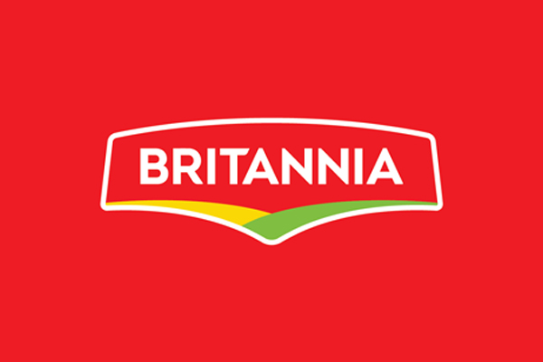
Problem Statement
Britannia, a leading FMCG brand, seeks to optimize its sales strategy by understanding customer preferences, product performance, regional sales trends, and more, Despite a strong marketing presence, identifying the most profitable products, and gender-based category preferences is a challenge. The goal is to leverage DATA ANALYTICS to uncover key metrics and patterns to drive data-driven decisions.

Slide 2
Business Objectives:
Identify Top-Selling Products: Determine which products contribute the most to overall sales and revenue.
Analyze Category Preferences by Gender: Understand gender-based preferences to enhance targeted marketing and product positioning.
Determine High-Revenue Cities: Pinpoint cities with the highest sales to optimize distribution and promotional strategies.
Optimize Sales Strategy: Leverage insights to improve pricing, marketing, and product availability.
Enhance Customer Engagement: Utilize data-driven insights to create personalized promotions and improve customer experience.

Slide 3
INSIGHTS:
Brown bread and premium bake rusk generate the most revenue, over 219k and 204k in Surat and Jaipur, respectively. Milk Rusk is the most preferred product in all five top cities:

Slide 4
INSIGHTS:
Bread (7.85%) and Cakes (7.39%) are the most favorable category by Females with a total of 35.5% contribution.
Biscuits (8.06% and Rusk (6.87%) are by Males with a total 32.6% contribution
And the same by Others with a total 31.7% contribution.

Slide 5
INSIGHTS:
Bangalore, Surat, Pune, Delhi and Chennai are the top cities by Revenue
Bangalore has the highest revenue with over 1.50M.

Slide 6

INSIGHTS:
Milk Rusk has contributed 43% of revenue generation, Bourbon 16%, Tiger and Marie Gold equally 15%, and Nutri-Choice only 11%.

Slide 7
INSIGHTS:
Overall 7018 Products were sold in July while 6115, and 5972 were in February and August respectively.

Slide 8
Optimize Sales Strategy
---Recommendations
To optimize Britannia’s sales strategy
the company should focus on expanding the distribution and availability of high-revenue products like Milk Rusk, Bourbon, and premium bake rusk, ensuring adequate stock levels in top-performing cities such as Bangalore, Surat, and Pune.
Additionally, pricing strategies can be adjusted based on demand patterns, and promotional efforts should be tailored to drive engagement, particularly in months with lower sales volumes like February and August.

Slide 9
Enhance Customer Engagement:
Britannia can improve customer engagement by leveraging gender-based preferences—
targeting female consumers with bread and cake promotions
while focusing on biscuits and rusk for male customers.
Personalized marketing campaigns, loyalty programs,
and bundled offers for high-performing products like Milk Rusk (43% revenue contribution) can
enhance customer retention. Additionally, city-specific promotions in high-revenue regions,
particularly Bangalore, can further strengthen brand loyalty and increase sales.

Slide 10
Conclusion & Next Steps:
Business Impact:
By leveraging these insights, Britannia can refine product positioning, optimize distribution strategies, and enhance targeted marketing efforts to drive sustained revenue growth.\
3. Next Steps:
Implement targeted promotions based on gender preferences.
Optimize inventory and pricing in high-revenue cities.
Introduce personalized engagement strategies to enhance customer loyalty.
Conduct further analysis on seasonal sales variations to improve demand forecasting.
Final Thought: Data-driven decisions empower Britannia to stay ahead in the competitive FMCG market. By aligning strategies with consumer preferences and market trends, the company can unlock new growth opportunities and maximize profitability.
THANKYOU! -
Utkarsh (Data Analyst)

